Slide 1
Image Processing and Pattern Recognition (IPPR):
(Lecture 4)

Slide 2
Spatial Filtering
• Use of spatial masks for filtering is called spatial filtering
– May be linear or nonlinear
• Linear filters
– Lowpass: attenuate (or eliminate) high frequency components such as characterized by edges and sharp details in an image
• Net effect is image blurring
– Highpass: attenuate (or eliminate) low frequency components such as slowly varying characteristics
• Net effect is a sharpening of edges and other details
– Bandpass: attenuate (or eliminate) a given frequency range
• Used primarily for image restoration(are of little interest for image enhancement)

Slide 3
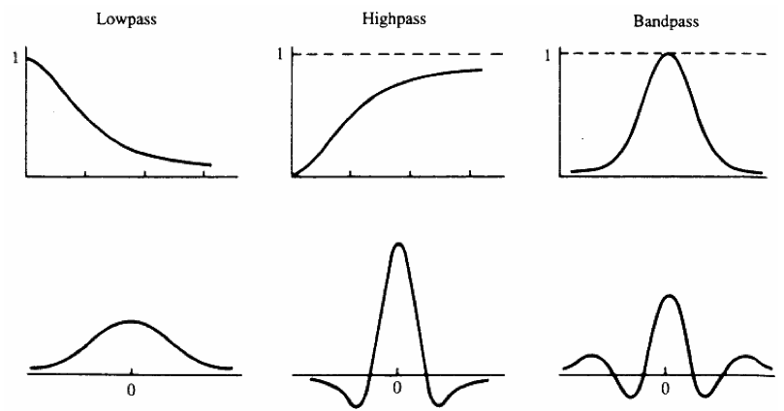
Spatial Filtering
• Filters in the frequency domain and corresponding spatial filters
• Basic approach is to sum products between mask coefficients and pixel values
– R=w1z1 +w2z2 +....+w9z9

Slide 4
Order-Statistic nonlinear spatial filters
• Nonlinear spatial filters also operate on neighborhoods
• Their operation is based directly on pixel values in the neighborhood under consideration
– They do not explicitly use coefficient values as in the linear spatial filters
• Example nonlinear spatial filters
– Median filter: Computes the median gray-level value of the neighborhood. Used for noise reduction.
– Max filter: Used to find the brightest points in an image
R=max{zk |k=1,2,...,9}
– Min filter: Used to find the dimmest points in an image
R=min{zk |k=1,2,...,9}

Slide 5
Neighbourhood Operations
Neighbourhood operations simply operate on a larger neighbourhood of pixels than point operations
Neighbourhoods are
mostly a rectangle
around a central pixel
Any size rectangle
and any shape filter
are possible
Origin
x
(x, y)
Neighbourhood
y
Image f (x, y)

Slide 6
Simple Neighbourhood Operations
Some simple neighbourhood operations include:
  Min: Set the pixel value to the minimum in the neighbourhood
  Max: Set the pixel value to the maximum in the neighbourhood
  Median: The median value of a set of numbers is the midpoint value in that set (e.g. from the set [1, 7, 15, 18, 24] 15 is the median). Sometimes the median works better than the average

Slide 7
Simple Neighbourhood Operations Example
Original Image
x
Enhanced Image
x
123
127
128
119
115
130
140
145
148
153
167
172
133
154
183
192
194
191
194
199
207
210
198
195
164
170
175
162
173
151
y
y

Slide 8
The Spatial Filtering Process
Origin
x
a
b
c
r
s
t
d
e
f
*
u
v
w
g
h
i
x
y
z
Original Image Pixels
Filter
Simple 3*3
Neighbourhood
e
3*3 Filter
e_{processed} = v*e +
r*a + s*b + t*c +
u*d + w*f +
x*g + y*h + z*i
y
Image f (x, y)
The above is repeated for every pixel in the original image to generate the filtered image

Slide 9
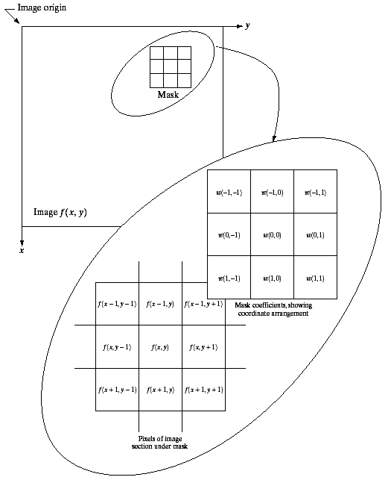
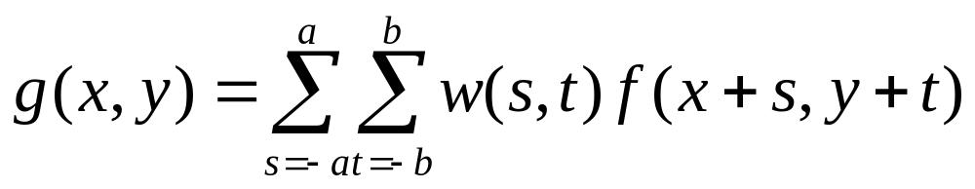
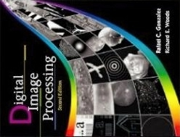
Spatial Filtering: Equation Form
Filtering can be given in equation form as shown above
Notations are based on the image shown to the left
Images taken from Gonzalez & Woods, Digital Image Processing (2002)

Slide 10
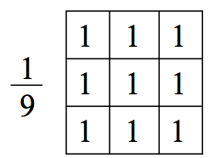
Smoothing Spatial Filters
• The shape of the impulse response needed to implement a lowpass (smoothing) filter indicates the filter should have all positive coefficients
• For a 3x3 mask, the simplest arrangement is to have all the coefficient values equal to one (neighborhood averaging)
– The response would be the sum of all gray levels for the nine pixels in the mask
– This could cause the value of R to be out of the valid gray-level range
• The solution is to scale the result by dividing by 9

Slide 11
Smoothing Spatial Filters
One of the simplest spatial filtering operations we can perform is a smoothing operation
  Simply average all of the pixels in a neighbourhood around a central value
  Especially useful
  in removing noise
  from images
  Also useful for
  highlighting gross
  detail
¹/₉ | ¹/₉ | ¹/₉
¹/₉ | ¹/₉ | ¹/₉
¹/₉ | ¹/₉ | ¹/₉
Simple averaging filter

Slide 12
Smoothing Spatial Filtering
Origin
x
104
100
108
¹/₉
¹/₉
¹/₉
99
106
98
*
¹/₉
¹/₉
¹/₉
95
90
85
¹/₉
¹/₉
¹/₉
Original Image Pixels
Filter
¹/₉
¹/₉
¹/₉
Simple 3*3
Neighbourhood
104
100
108
3*3 Smoothing
Filter
¹/₉
¹/₉
¹/₉
99
106
98
¹/₉
¹/₉
¹/₉
95
90
85
e = ¹/₉*106 +
¹/₉*104 + ¹/₉*100 + ¹/₉*108 +
¹/₉*99 + ¹/₉*98 +
¹/₉*95 + ¹/₉*90 + ¹/₉*85
= 98.3333
y
Image f (x, y)
The above is repeated for every pixel in the original image to generate the smoothed image

Slide 13
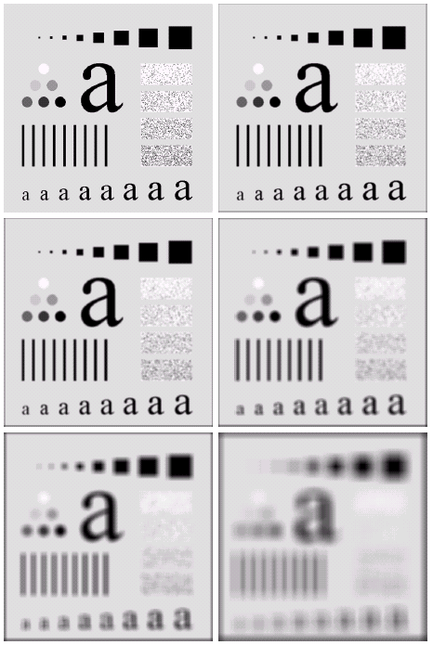
Image Smoothing Example
The image at the top left
is an original image of
size 500*500 pixels
The subsequent images
show the image after
filtering with an averaging
filter of increasing sizes
  3, 5, 9, 15 and 35
Notice how detail begins
to disappear
Images taken from Gonzalez & Woods, Digital Image Processing (2002)

Slide 14
Image Smoothing Example
Images taken from Gonzalez & Woods, Digital Image Processing (2002)

Slide 15
Image Smoothing Example
Images taken from Gonzalez & Woods, Digital Image Processing (2002)

Slide 16
Image Smoothing Example
Images taken from Gonzalez & Woods, Digital Image Processing (2002)

Slide 17
Image Smoothing Example
Images taken from Gonzalez & Woods, Digital Image Processing (2002)

Slide 18
Image Smoothing Example
Images taken from Gonzalez & Woods, Digital Image Processing (2002)

Slide 19
Image Smoothing Example
Images taken from Gonzalez & Woods, Digital Image Processing (2002)

Slide 20
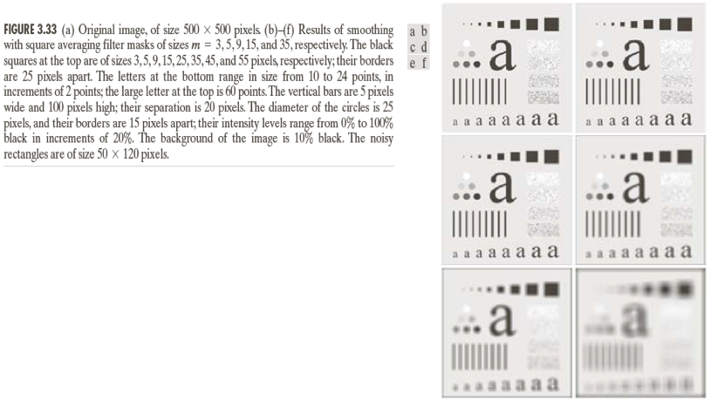
Image Smoothing Example
Images taken from Gonzalez & Woods, Digital Image Processing (2002)

Slide 21
Weighted Smoothing Filters
More effective smoothing filters can be generated by allowing different pixels in the neighbourhood different weights in the averaging function
  Pixels closer to the
  central pixel are more
  important
  Often referred to as a
  weighted averaging
¹/₁₆ | ²/₁₆ | ¹/₁₆
²/₁₆ | ⁴/₁₆ | ²/₁₆
¹/₁₆ | ²/₁₆ | ¹/₁₆
Weighted averaging filter

Slide 22
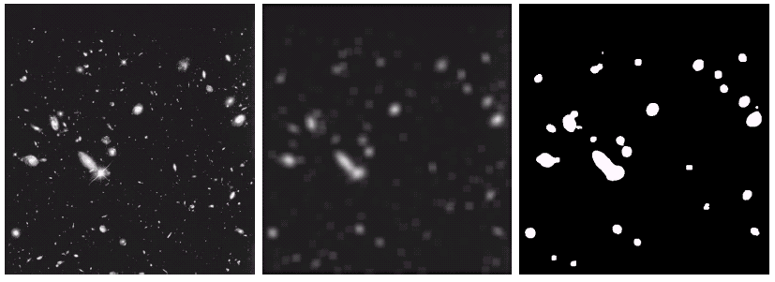
Another Smoothing Example
By smoothing the original image we get rid of lots of the finer detail which leaves only the gross features for thresholding
Images taken from Gonzalez & Woods, Digital Image Processing (2002)
Original Image
Smoothed Image
Thresholded Image

Slide 23
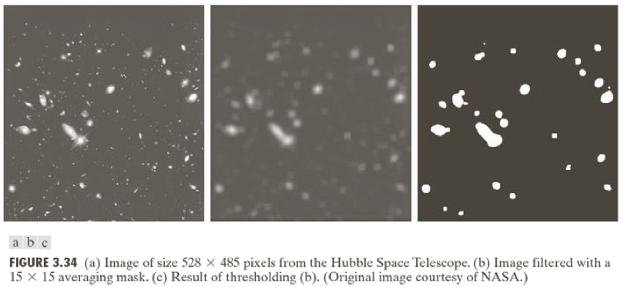
Another Smoothing Example
Images taken from Gonzalez & Woods, Digital Image Processing (2002)

Slide 24
Smoothing Filters
• One problem with the lowpass filter is it blurs edges and other sharp details
• If the intent is to achieve noise reduction, one approach can be to use median filtering
– The value of each pixel is replaced by the median pixel value in the neighborhood (as opposed to the average)
– Particularly effective when the noise consists of strong, spike like components and edge sharpness is to be preserved
• The median m of a set of values is such that half of the values are greater than m and half are less than m
• To implement, sort the pixel values in the neighborhood, choose the median and assign this value to the pixel of interest
• Forces pixels with distinct intensities to be more like their neighbors

Slide 25

Averaging Filter Vs. Median Filter Example
Original Image
With Noise
Image After
Averaging Filter
Image After
Median Filter
Images taken from Gonzalez & Woods, Digital Image Processing (2002)
Filtering is often used to remove noise from images
Sometimes a median filter works better than an averaging filter

Slide 26
Averaging Filter Vs. Median Filter Example
Images taken from Gonzalez & Woods, Digital Image Processing (2002)

Slide 27
Averaging Filter Vs. Median Filter Example
Images taken from Gonzalez & Woods, Digital Image Processing (2002)

Slide 28
Averaging Filter Vs. Median Filter Example
Images taken from Gonzalez & Woods, Digital Image Processing (2002)

Slide 29
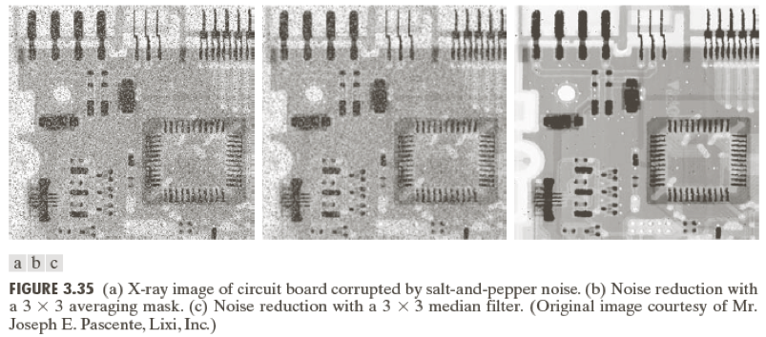
Averaging Filter Vs. Median Filter Example
Images taken from Gonzalez & Woods, Digital Image Processing (2002)

Slide 30
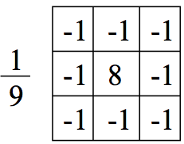
Sharpening Filters (High Pass)
• The shape of the impulse response needed to implement a high-pass (sharpening) filter indicates the filter should have positive coefficients near its center and negative coefficients in the outer periphery
• For a 3x3 mask, the simplest arrangement is to have the center coefficient positive and all others negative

Slide 31
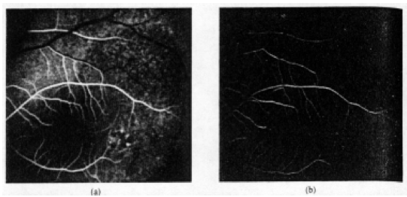
Sharpening Filters (High Pass)

